Slide 1
Filesystem and Management of Data Storages
Lecture 6
CoSc2043 – Network and System Administration

Slide 2
Section Overview
Devices and Files
Filesystem Management
Network Filesystems
Backups

Slide 3
Kinds of Devices
Physical Devices
  Actual hardware
  Examples
    Hard Drives, CDROMs, Floppy
    Network cards and modems
Logical Devices
  Pseudo devices
  Examples
    Virtual Terminals
    Network Ports

Slide 4
Device Drivers and Files
Device drivers
  Software to control hardware
  Compiled into the kernel
  Dynamically loaded module
Device files
  Located in /dev
  Provide application access to device
  Driver must also be present to use

Slide 5
Making Device Files
mknod filename type major minor
filename: Name of the device file
Type
  “c” – Character Device
  “b” – Block Device
Major Number: Type of device driver
Minor Number: Instance (which one)
/dev/MAKEDEV: Creation program

Slide 6
Disk Interfaces
SCSI
  Standard interface for servers.
IDE
  Standard interface for PCs.
Fibre Channel (FC-AL)
  High bandwidth
  Can run SCSI or IP
iSCSI
  SCSI over fast (e.g., 10-gigabit) IP network equipment.
USB
  Fast enough for slow devices on PCs.

Slide 7
SCSI
Small Computer Systems Interface
Fast, reliable, expensive.
A bus, not a simple PC to device interface.
  Each device has a target # ranging 0-7 or 0-15.
  Devices can communicate directly w/o CPU.
Many versions
  Original: SCSI-1 (1979) 5MB/s
  Current: SCSI-3 (2001) 320MB/s
Serial Attached SCSI (SAS)
  Up to 128 devices
  Up to 750 MB/s full duplex.

Slide 8
IDE
Integrated Drive Electronics / AT attachment
  Slower, less reliable, cheap.
  Only allows 2 devices per interface.
  ATAPI standard added removable devices.
Many versions
  Original: IDE / ATA (1984)
  Current: Ultra-ATA/133 133MB/s
Serial ATA
  Up to 128 devices.
  150 MB/s (SATA-1) and 300 MB/s (SATA-2)

Slide 9
IDE vs. SCSI
SCSI offers better performance/scale
  Faster bus
  Faster hard drives (up to 15,000rpm).
  Lower CPU usage
  Better handling of multiple requests.
Cheaper IDE often best for workstations.
Convergence
  SATA2 and SAS converging on a single std.

Slide 10
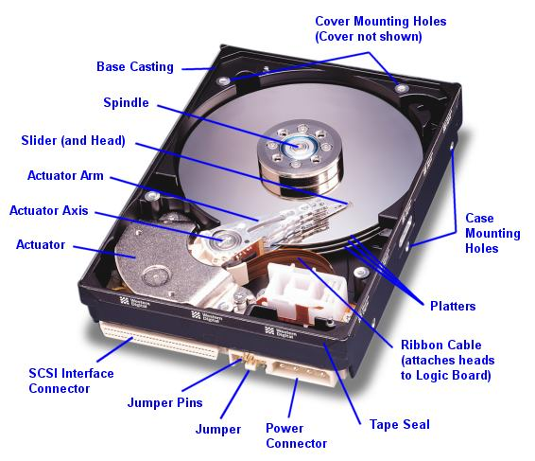
Hard Drive Components
Notes:
Picture from Western Digital.

Slide 11
Hard Drive Components
Actuator
  Moves arm across disk to read/write data.
  Arm has multiple read/write heads (often 2/platter.)
Platters
  Rigid substrate material.
  Thin coating of magnetic material stores data.
  Coating type determines areal density: Gbits/in2
Spindle Motor
  Spins platters from 3600-15,000 rpm.
  Speed determines disk latency.
Cache
  8-32MB of cache memory
  Reliability: write-back vs. write-through

Slide 12
Disk Information: hdparm
# hdparm -i /dev/hde
/dev/hde:
Model=WDC WD1200JB-00CRA1, FwRev=17.07W17, SerialNo=WD-WMA8C4533667
Config={ HardSect NotMFM HdSw>15uSec SpinMotCtl Fixed DTR>5Mbs FmtGapReq }
RawCHS=16383/16/63, TrkSize=57600, SectSize=600, ECCbytes=40
BuffType=DualPortCache, BuffSize=8192kB, MaxMultSect=16, MultSect=off
CurCHS=16383/16/63, CurSects=16514064, LBA=yes, LBAsects=234441648
IORDY=on/off, tPIO={min:120,w/IORDY:120}, tDMA={min:120,rec:120}
PIO modes: pio0 pio1 pio2 pio3 pio4
DMA modes: mdma0 mdma1 mdma2
UDMA modes: udma0 udma1 udma2 udma3 udma4 *udma5
AdvancedPM=no WriteCache=enabled
Drive conforms to: device does not report version:
* signifies the current active mode

Slide 13
Disk Performance
Seek Time
  Time to move head to desired track (3-8 ms)
Rotational Delay
  Time until head over desired block (8ms for 7200)
Latency
  Seek Time + Rotational Delay
Throughput
  Data transfer rate (20-100 MB/s)
Notes:
(60 min/s) (7200 rots/min) = 1/120 s/rot =~ 8ms
Write times are slower (seek time +1ms, throughput slower too)

Slide 14
Latency vs. Throughput
Which is more important?
  Depends on the type of load.
Sequential access – Throughput
  Multimedia on a single user PC
Random access – Latency
  Most servers
How to improve performance
Faster disks (15 krpm vs 7200rpm)
Caching (disk, controller, server OS, client OS)
  More spindles (disks).
  More disk controllers.

Slide 15
Disk Performance: hdparm
# hdparm -tT /dev/sda
/dev/sda:
Timing cached reads: 1954 MB in 2.00 seconds = 977.02 MB/sec
Timing buffered disk reads:
268 MB in 3.02 seconds = 88.66 MB/sec

Slide 16
Reliability
MTBF
  Average time between failures (>100,000 hours).
Real failure curves
  Early phase: high failure rate from defects.
  Constant failure rate phase: MTBF valid.
  Wearout phase: high failure rate from wear.
Failures more likely on traumatic events.
  Power on/off.
Systems often wear out before MTBF.
Notes:
Mean Time Between Failure (MTBF) measures the average time that equipment is operating between breakdowns or stoppages

Slide 17
UNIX Filesystems
Defines how data is stored on drives
Multiple types of filesystems supported
Boot Block (1st block)
  Stores the bootstrap loader program
Superblock (2nd block)
  Copies scattered throughout the partition
  Stores information about the partition
    Partition Size
    Type of File system
    Block Size
    Size & Location of inode tables
    Free Block list

Slide 18

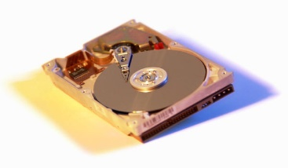
Filesystems and Partitions
/ (root)
bin
home
etc
usr
var
scott
alice
bob
bin
sbin
local
lib
bin
man
lib
share
src

Slide 19
Why Partition?
Not enough space on one disk
Separation of data
  Read-only areas
  Spool areas and free space
  OS upgrades
Backups
Performance

Slide 20
RAID
Redundant Array of Independent Disks
Combine physical disks into single logical unit.
Can be implemented in hardware or software.
Hardware RAID controllers:
Caching
Automate rebuilding of arrays
Advantages
  Capacity
  Reliability
  Throughput

Slide 21
RAID Levels
Level | Min | Description
JBOD | 2 | Merge disks for capacity, no striping.
RAID 0 | 2 | Striped for performance + capacity.
RAID 1 | 2 | Mirrored for fault tolerance.
RAID 3 | 3 | Striped set with dedicated parity disk.
RAID 4 | 3 | Block instead of byte level striping.
RAID 5 | 3 | Striped set with distributed parity.
RAID 6 | 4 | Striped set with dual distributed parity.
Slide #<number>

Slide 22
Striping
Distribute data across multiple disks.
Improve I/O by accessing disks in parallel.
  Independent requests can be serviced in parallel by separate disks.
  Single multi-block requests can be serviced by multiple disks.
Performance vs. reliability
  Performance increases with # disks.
  Reliability decreases with # disks.

Slide 23
Managing Filesystems
Creating a new filesystem
  Similar to DOS format
  mkfs – creates a filesystem (many aliases)
mount – mount a partition
  Mount point must exist (directory)
  /etc/fstab
umount – Unmount a partition
fsck
  Check/fix filesystem errors
  Journaling filesystems
Quotas?
Notes:
Mounting makes file systems, files, directories, devices and special files available for use and available to the user

Slide 24
Network Filesystems
Filesystems shared via NFS
Client-side: similar to local mount
Server – exports shared filesystems
  mountd and nfsd
  /etc/exports and exportfs
  Access permissions should be selective
showmount -e
Samba – Microsoft filesystem sharing
Notes:
you export (share) one or more directories by listing them in the /etc/exports file and by running the exportfs command
showmount will show mountable file systems on remote machines
Samba provides file and print services for various Microsoft Windows clients and can integrate with a Microsoft Windows Server domain, either as a Domain Controller or as a domain member.

Slide 25
Why Backups?
Hardware failures
Accidental deletions or modification
Security incidents
Upgrades and Migrations

Slide 26
Backup Plan Characteristics
Ease of use
  Automation of backups
  Selective file/directory restores
Time scheduling
Backup verification
Offsite copies
Portability

Slide 27
Backup Media
Floppy Disks
CD-R and CD-RW Drives
Removal Hard drives and Zipdrives
Tape
  4mm DAT
  8mm
  DLT

Slide 28
Backup tools
dump and restore
  filesystem backups
  Support for incremental backups
tar
  File by file backups (archives)
  Easy to recover selected files
dd – Duplicate “raw” devices
mt – Control tape devices
Compression tools
  compress
  gzip

Slide 29
Backup Strategies
Full Backups – Backup entire system
Partial Backups – Selective backup
Incremental – Backup modified files
Basic plan
  Full backup on Sundays
  Incremental daily

